Slide 1
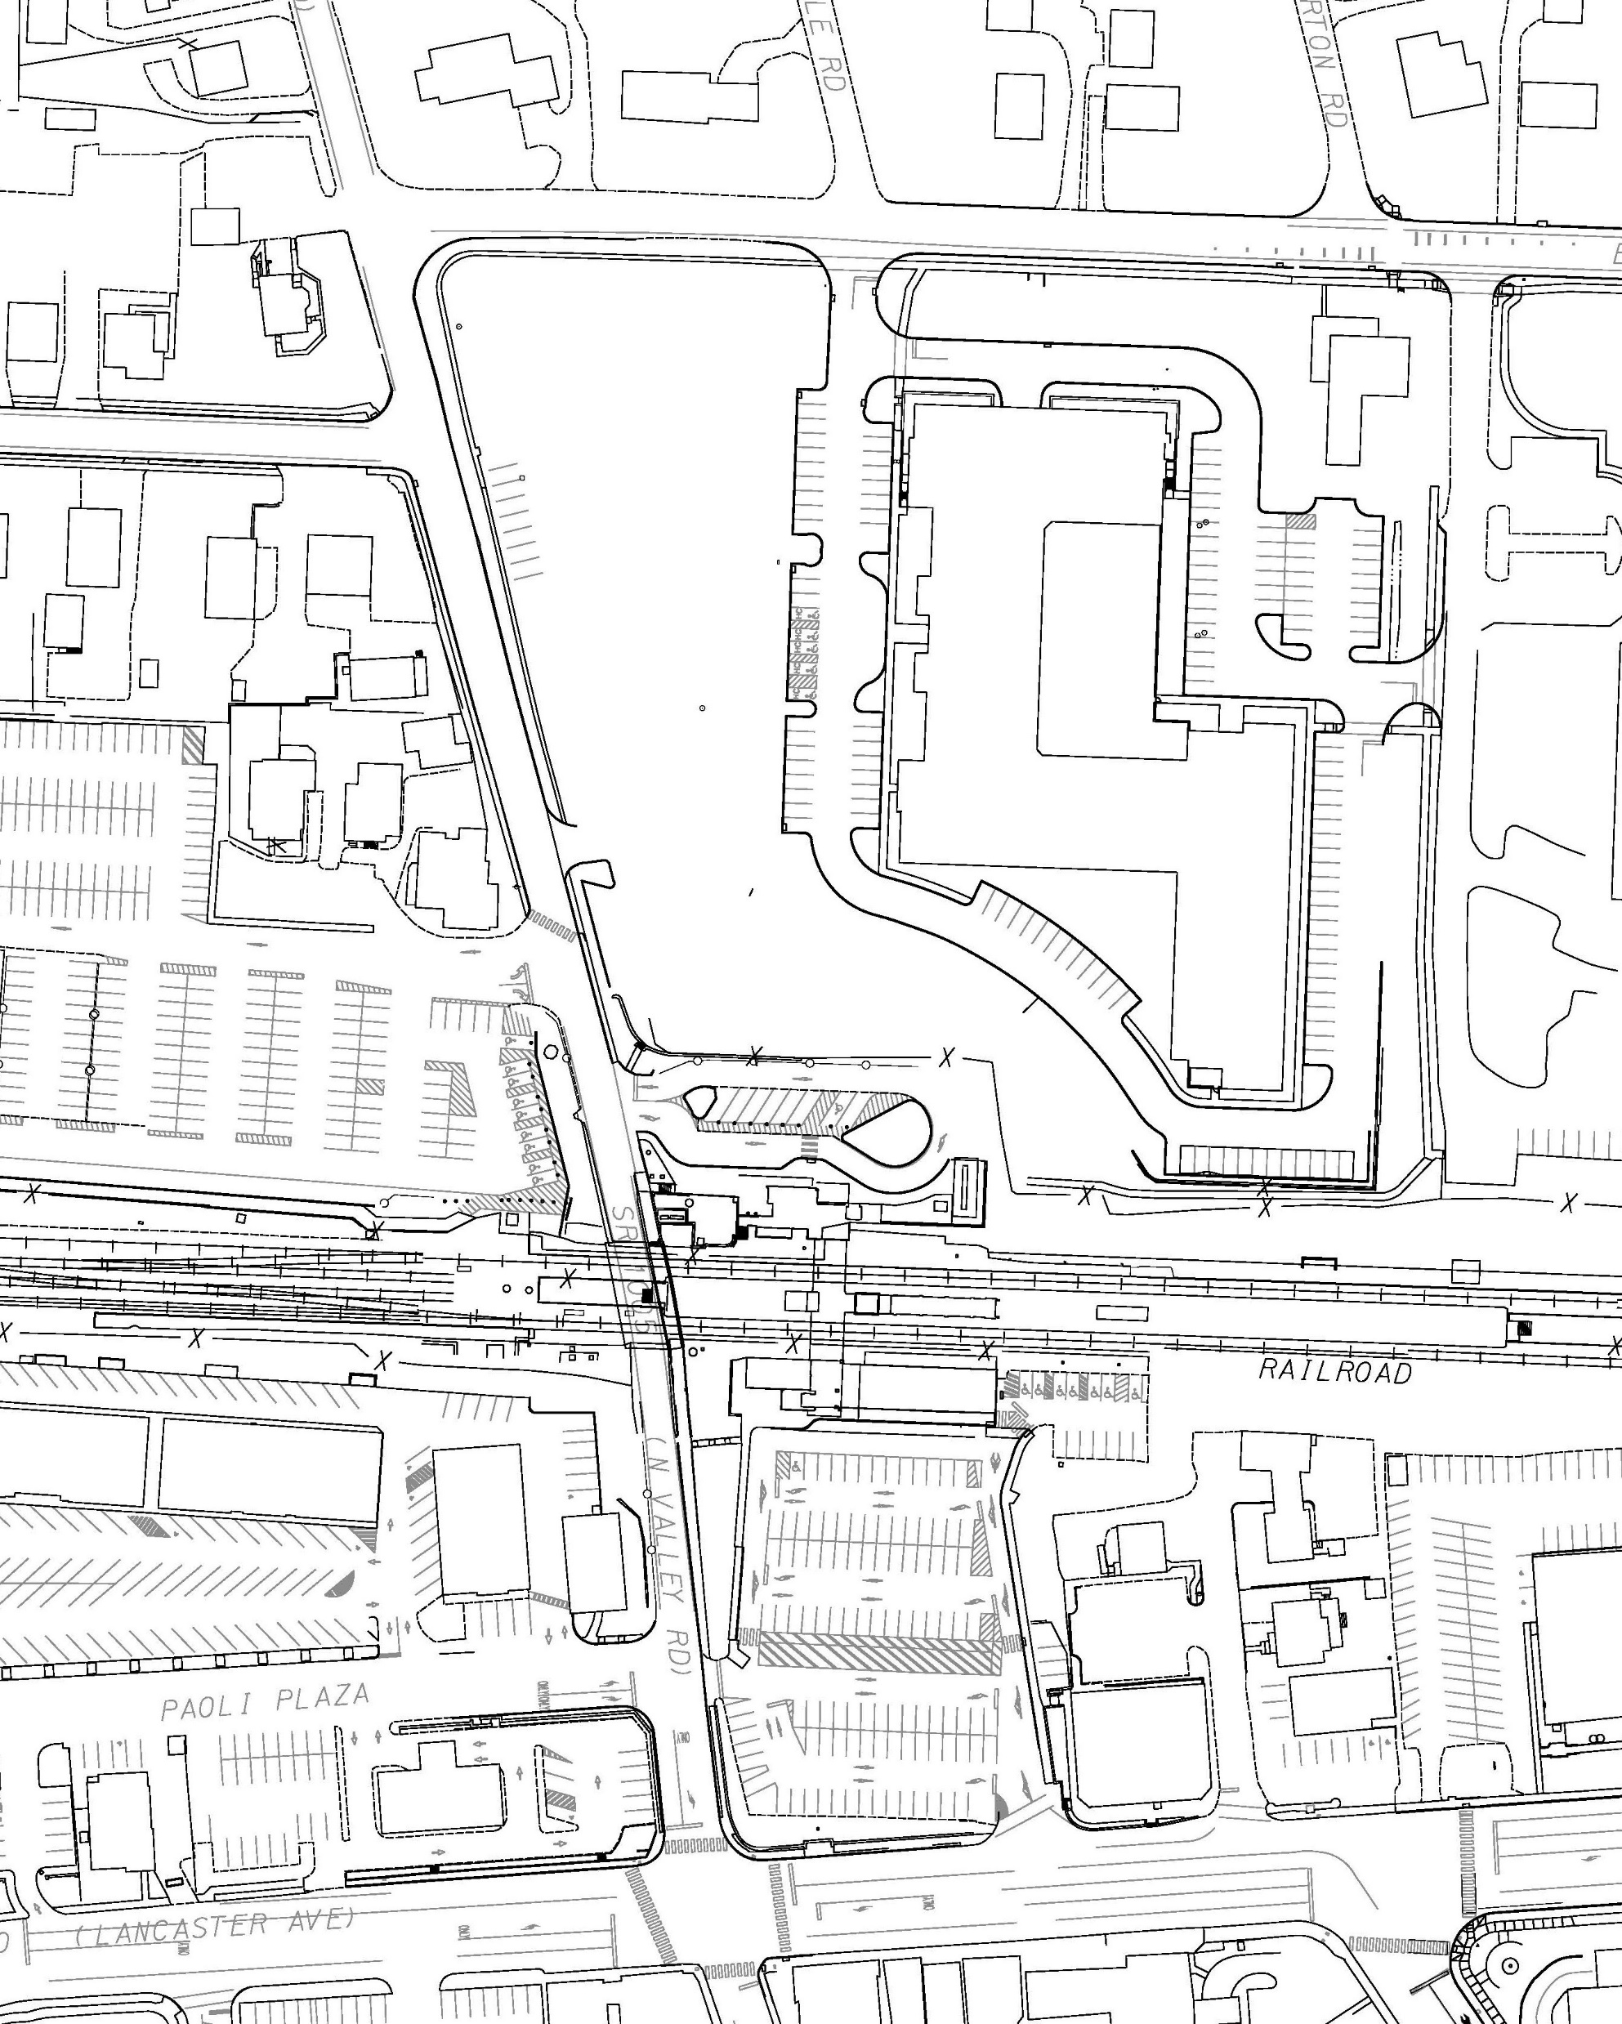
Traffic control-stage 1B&1C
Half width construction with one lane open to homes at all times.
East Central Ave.
West Central Ave.
North Valley Rd.
Work Zone
Completed Construction
Train Station
Lancaster Ave.
22
Revised 2-12-24

Slide 2
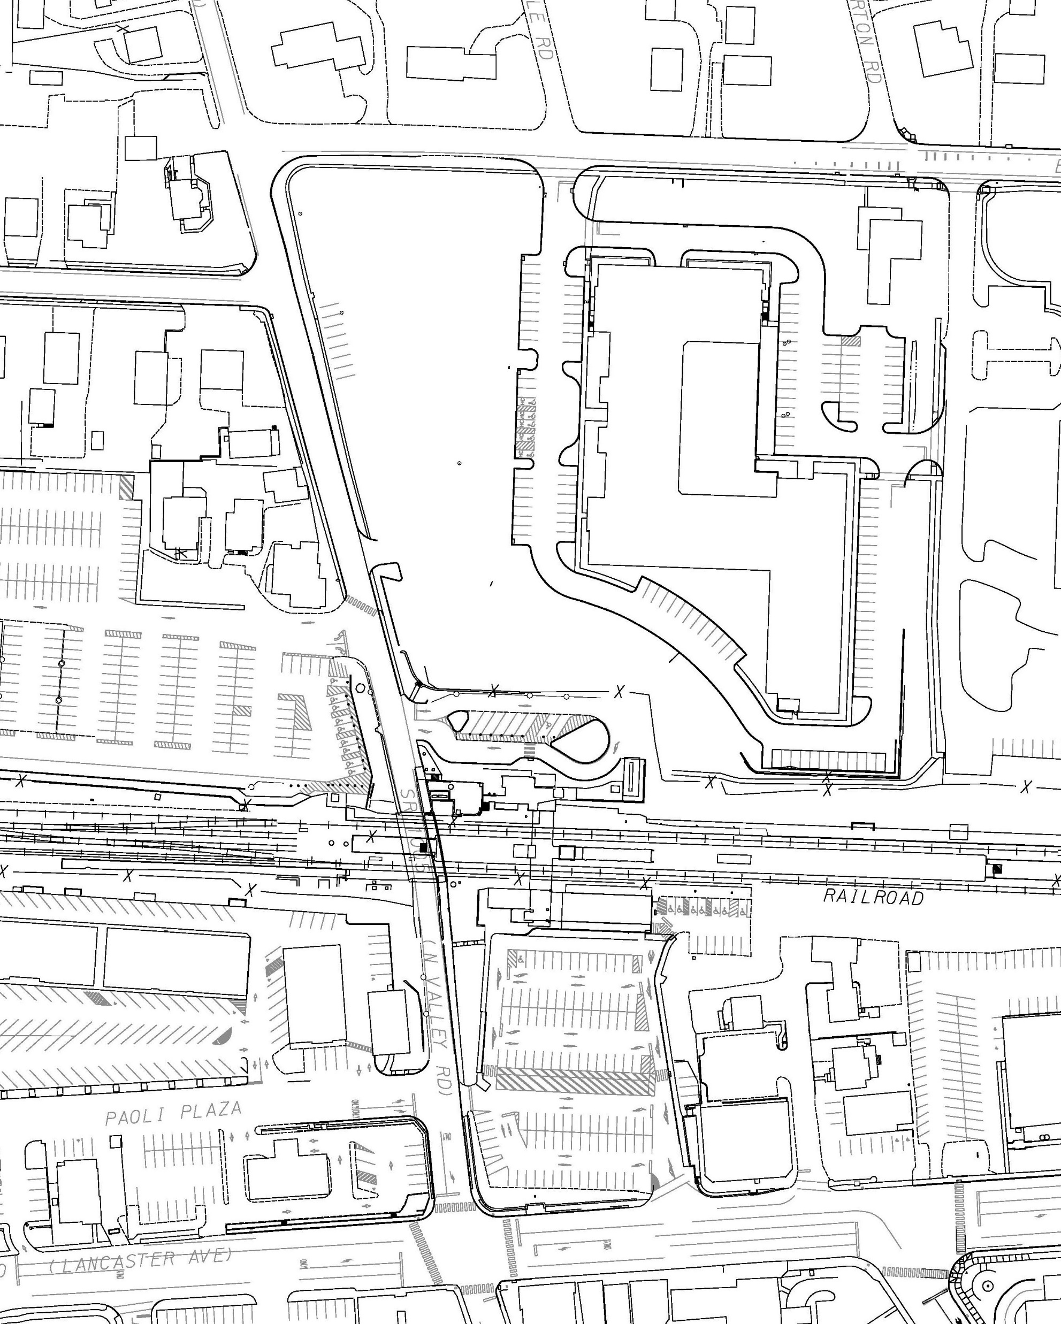
Traffic control-stage 1D
East Central Ave.
West Central
Ave.
- Temporary traffic signal installed at Central Ave/North Valley Rd.
North Valley Rd.
Work Zone
- Half width construction with one lane open through to Knob Hill Lane for large trucks & EMS at all times.
Completed Construction
Train Station
Lancaster Ave.
24
Revised 2-12-24

Slide 3
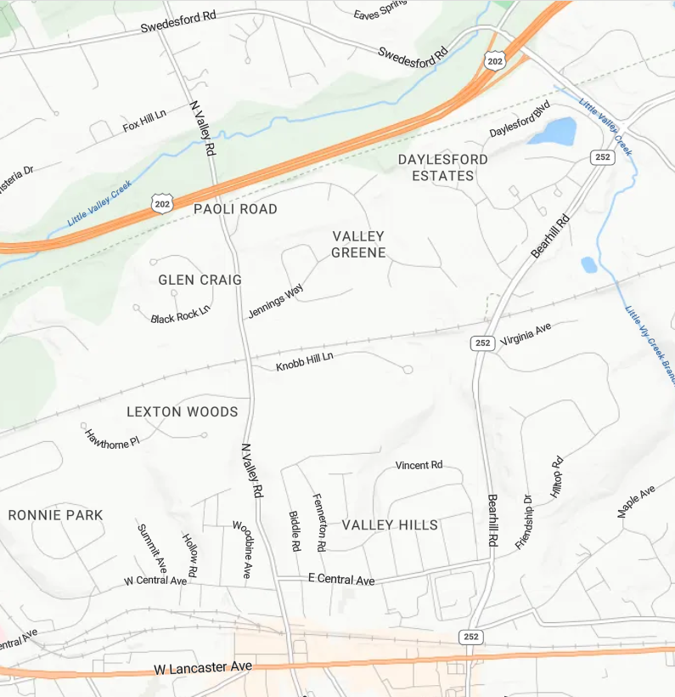
Traffic control-Detour
North Valley Road Detour
NB Detour (3 miles)
SB Detour (3 miles)
Road Closure Area
(road open for large trucks and EMS)
25

Slide 4
Traffic control-stage 1E&1F
East Central Ave.
West Central Ave.
- Temporary traffic signal installed at Central Ave/North Valley Rd.
North Valley Rd.
Work Zone
- Half width construction with one lane open to homes at all times.
Completed Construction
Train Station
Lancaster Ave.
26

Slide 5
Traffic control-stage 2A&2B
Traffic switched to new bridge and roadway
Existing Bridge removed
Train station and parking remains open.
East Central Ave.
West Central Ave.
- Temporary traffic signal installed at Central Ave/North Valley Rd.
Work Zone
North Valley Rd.
Completed Construction
- Access to business and residential driveways to be maintained during construction.
Train Station
Lancaster Ave.
28
Revised 2-12-24

Slide 6
Traffic control-stage 3&4
East Central Ave.
West Central Ave.
- Access through to Knob Hill Lane for large trucks & EMS at all times.
Work Zone
Completed Construction
North Valley Rd.
Train Station
Stage 3 – Install islands at roundabout
Stage 4 – Final paving of all project areas
Lancaster Ave.
29
Revised 2-12-24

Slide 7
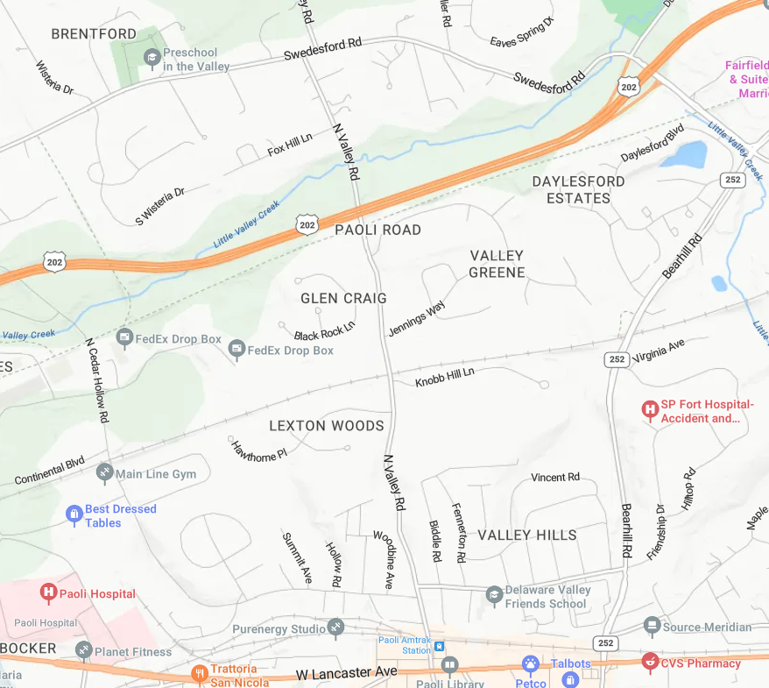
detour
North Valley Rd./Central Ave Int. Detour
EB Detour (4.1 miles)
WB Detour (4.1 miles)
Road Closure Area
(road open for large trucks and EMS)
Revised
2-12-24
30

