Slide 1
PennDOT Project Information
Culvert Replacement Projects
SR 30 (Ardmore Boulevard)
Sections A31 and A32
Borough of Forest Hills
Allegheny County, PA

Slide 2
Project Team
CDR Maguire:
Matt Macey, P.E. – Project Manager
Joe Sasso, P.E. – Roadway Lead
PennDOT District 11-0:
Mark Krajcovic, P.E. – Project Manager
Mark Young – District Environmental Manager
Nick Krobot, P.E. - Assistant Environmental Project Manager
Steve Cowan – District Press Officer
Direct questions to Mark Krajcovic, P.E. at
412-429-2812
mkrajcovic@pa.gov
Please complete the survey at the end of the presentation.

Slide 3
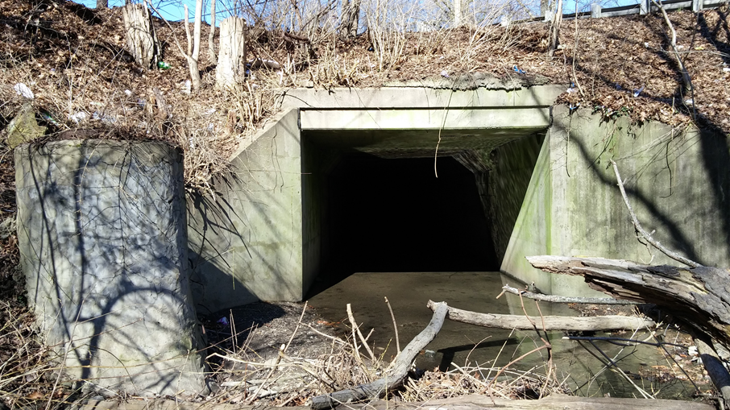
Project Description
PROJECT DESCRIPTION
The purpose of the project is to maintain safe and reliable crossings of Ardmore Boulevard over Falls Run. The scope of work for the project is to replace the existing culverts with new concrete box culverts.
The purpose of this presentation is to introduce the project to the public and gather feedback of the proposed park impacts for Section A31.
SR 30
Section A31
SR 30
Section A32

Slide 4
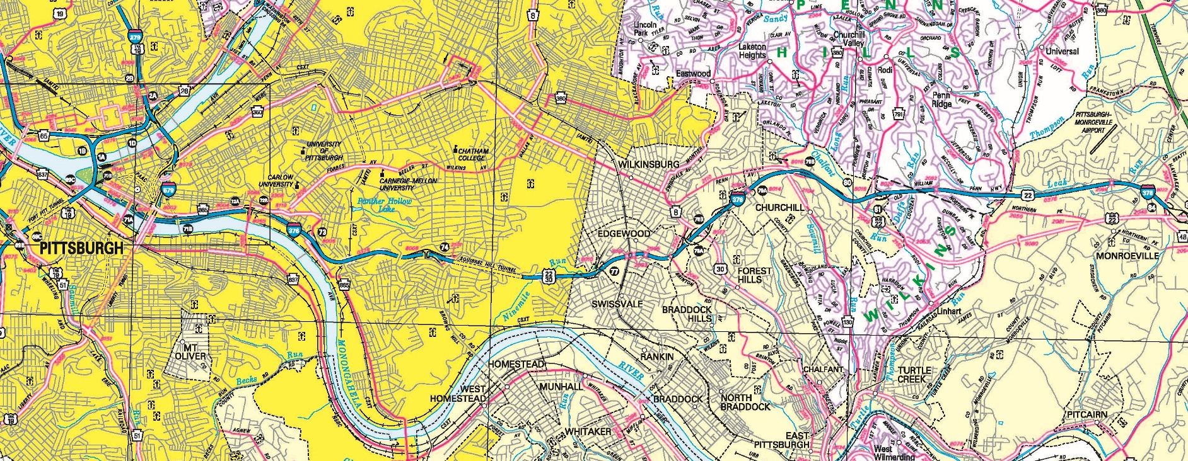
Project Location & Schedule
PROJECT LOCATION
A32
A31
This project will be completed in 2 phases. SR 30 will not be detoured and the project will take approximately 9 weeks to complete
4 weeks for Phase 1 (A31 culvert)
5 weeks for Phase 2 (A32 culvert)

Slide 5
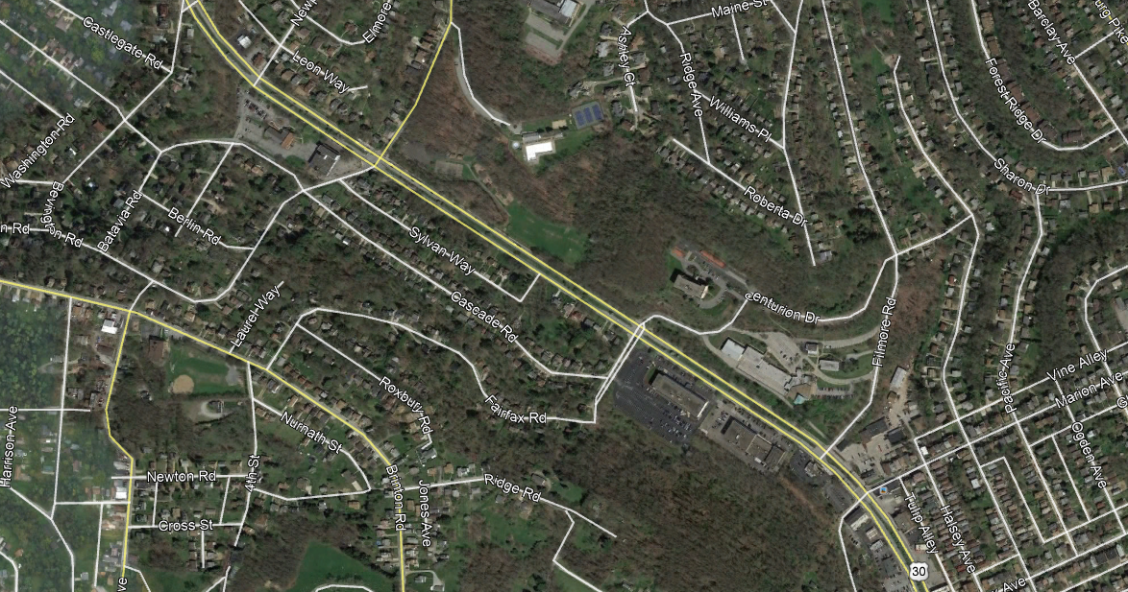
SR 30, Section A31
PROJECT DESCRIPTION & LOCATION
Existing culvert:
Normal (perpendicular) span of 12-ft
Will be replaced with:
Reinforced concrete box culvert
14-ft wide x 10-ft high
A31 project limits:
700-feet to the west
800-feet to the east
Total project length of approximately 0.284-miles.
A31

Slide 6
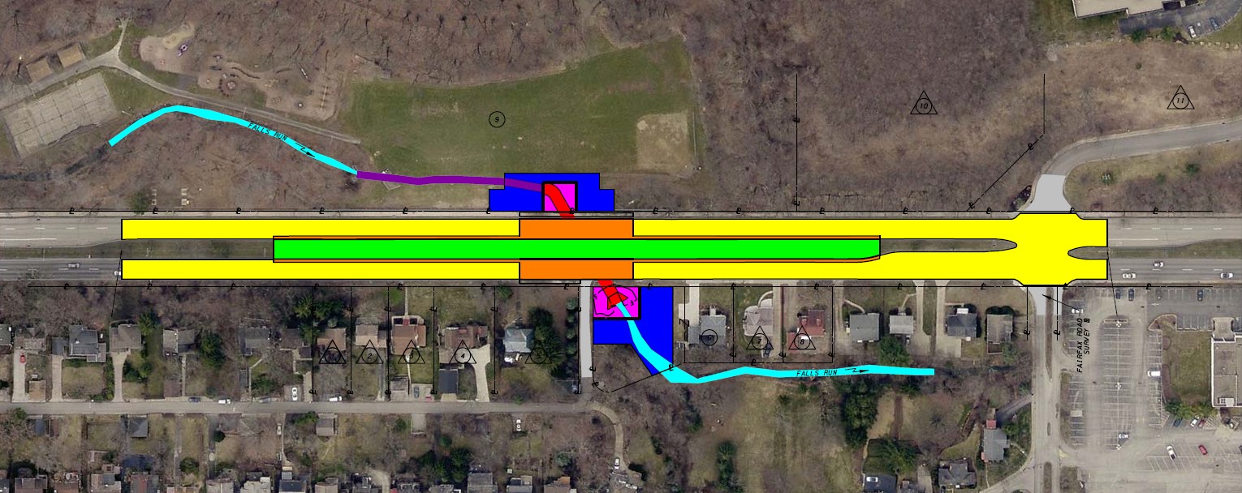
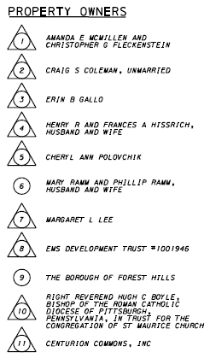
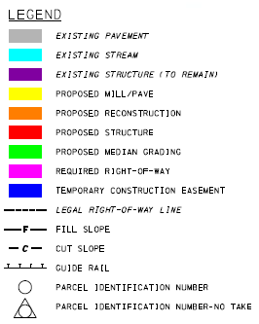
SR 30, Section A31
PROJECT IMPACTS
The project will take approximately 4 weeks to complete.
SR 30 will not be closed and detoured.
Work will be completed on half of the road at one time.
Traffic patterns will be as shown on the next slide.
Forest Hills Park impacts will be minimal and only occur in the area directly adjacent to the culvert. In addition, there will be no impacts to the baseball field or any other park amenities.

Slide 7
SR 30, Section A31
TRAFFIC CONTROL
TRAFFIC CONTROL

Slide 8
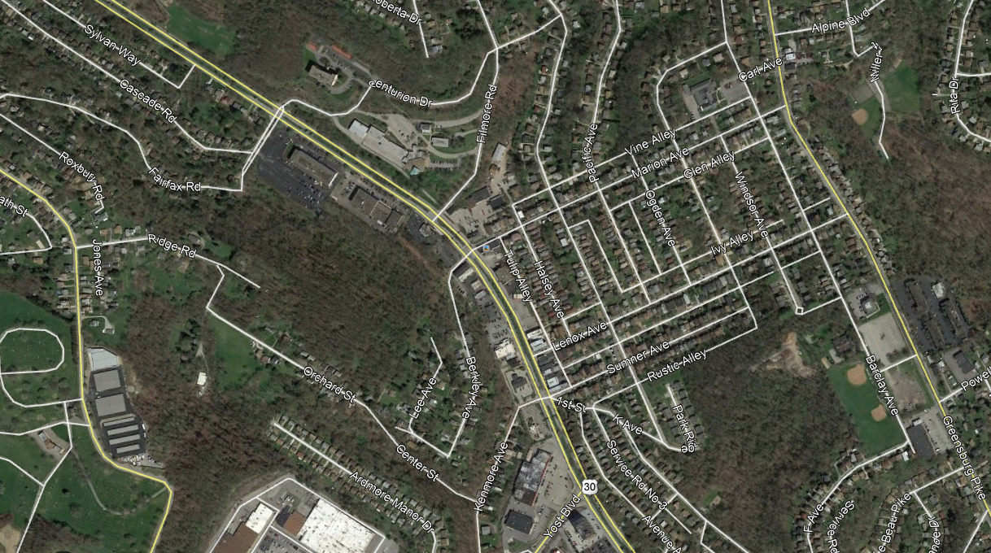
SR 30, Section A32
PROJECT DESCRIPTION & LOCATION
Existing culvert:
Clear span of 8-ft
Will be replaced with:
Reinforced concrete box culvert
10-ft wide x 5-ft high
A32 project limits:
952-feet to the west
938-feet to the east
Total project length of approximately 0.358-miles.
A32

Slide 9
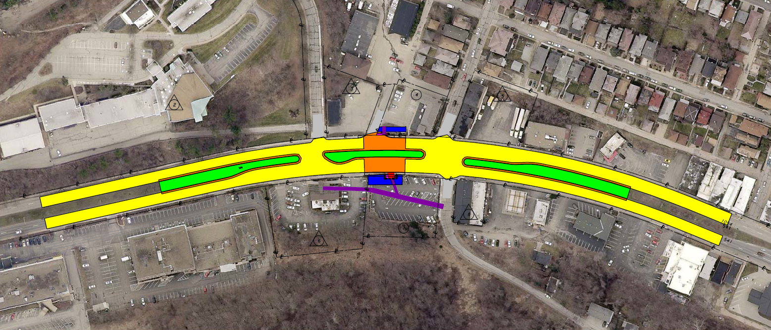
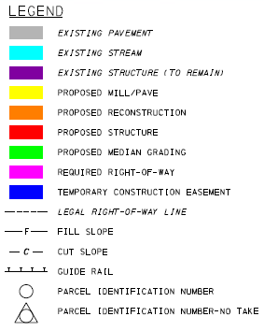
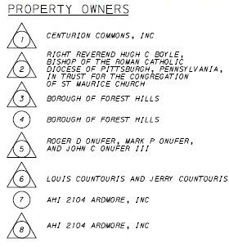
SR 30, Section A32
PROJECT IMPACTS
The project will take approximately 5 weeks to complete.
SR 30 will not be closed and detoured.
Work will be completed on half of the road at one time.
Traffic patterns will be as shown on the next slide.

Slide 10
SR 30, Section A32
TRAFFIC CONTROL
TRAFFIC CONTROL

Slide 11
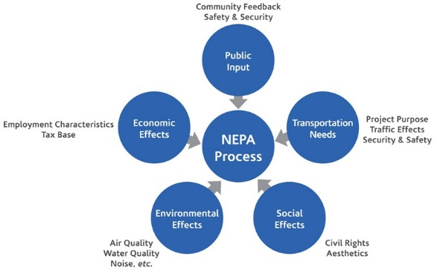
National Environmental
Policy Act (NEPA)
NEPA
The transportation design-making process includes feedback from public. In addition, public outreach is part of the NEPA (National Environmental Policy Act) process:
NEPA requires agencies to integrate environmental values into their decision-making processes by considering the environmental impacts of their proposed actions and reasonable alternatives to those actions
NEPA also includes public involvement activities and gathering feedback from the public

Slide 12
Project Survey
Please complete the survey below
in order to provide feedback:
https://www.surveymonkey.com/r/7M82W35

